Slide 1
Political violence
Causes, types and impact of political violence

Slide 2
Introduction to Political Violence
Definition: Political violence refers to the use of force or threats by individuals, groups, or governments to achieve political objectives.
Key Features:
Acts that disrupt peace and social order
Can target governments, institutions, or civilians
Often used to assert power or bring about social or political change

Slide 3
Causes of Political Violence
Social and Economic Inequality:
When large segments of the population feel marginalized or oppressed, political violence may arise as a form of resistance.
Economic disparities, unequal access to resources, and lack of social mobility are key factors.
Example: Economic inequality in Latin America led to several revolutions and insurgencies in the 20th century.

Slide 4
Causes of Political Violence
Ethnic and Religious Tensions:
Political violence is often fueled by ethnic or religious divisions within a society.
Conflicts between groups can escalate into violence when political structures fail to address their demands.
Example: The Rwandan Genocide (1994) between the Hutu and Tutsi ethnic groups, where years of ethnic division culminated in mass violence.
When governments engage in repressive actions to maintain power, opposition groups often resort to violence as a form of resistance.

Slide 5
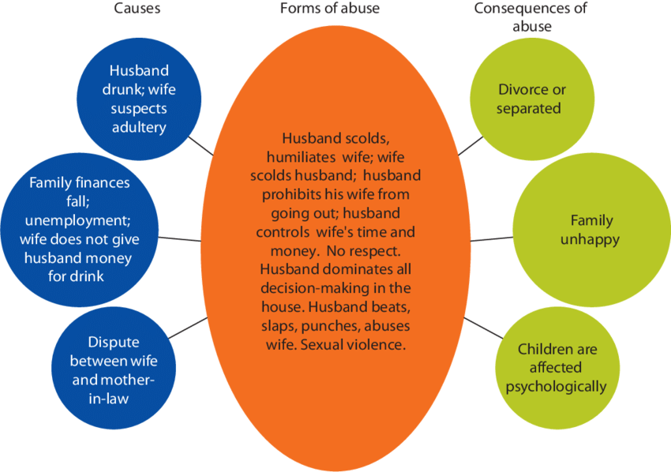

Slide 6
Forms of Political Violence
Revolutionary Violence:
Revolutionary violence involves attempts to overthrow a government or political system, often aiming to establish a new regime or system.
Revolution can arise out of dissatisfaction with political systems, social inequalities, or governance failures.
Example: The French Revolution (1789) was a direct response to political and social oppression Civil wars occur when different political factions within a country use violence to achieve their goals.
.

Slide 7
Forms of Political Violence
Terrorism:
Terrorism involves violent acts that target non-combatants to instill fear and achieve political objectives.
Terrorists often seek to destabilize governments or spread a political or ideological message.
Example: Al-Qaeda’s attacks on September 11, 2001, aimed to provoke global instability and challenge U.S. policies in the Middle East.

Slide 8
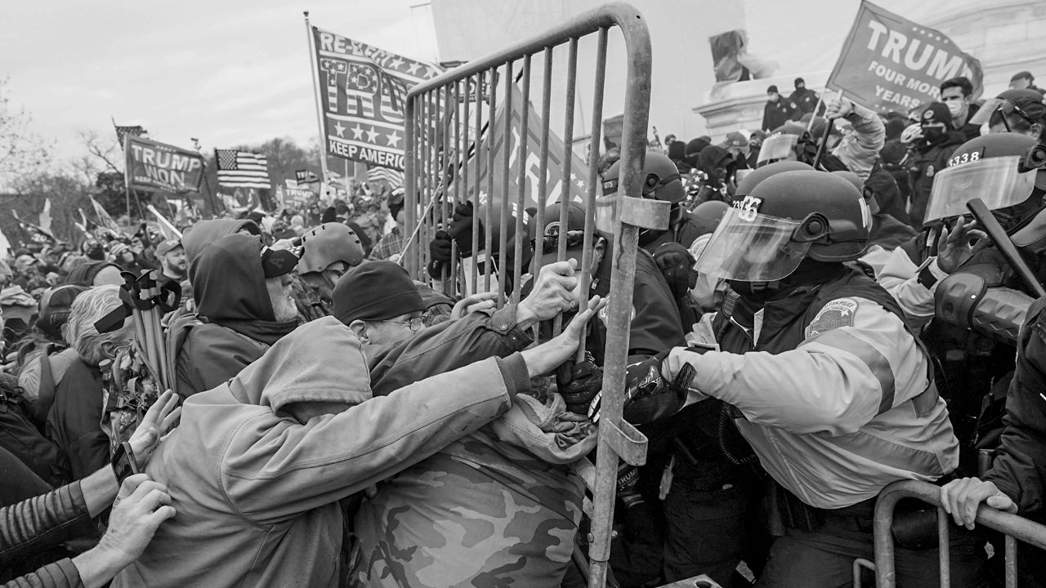
Political violence is a complex phenomenon that arises from a combination of social, economic, and political factors.

Slide 9
Impact of Political Violence
Economic Destruction:
War and political violence destroy infrastructure, disrupt industries, and impede economic growth.
The cost of rebuilding and maintaining stability after such events is often extremely high.
Example: The wars in Afghanistan and Iraq have resulted in massive economic costs, leaving the countries' economies severely impacted.

Slide 10
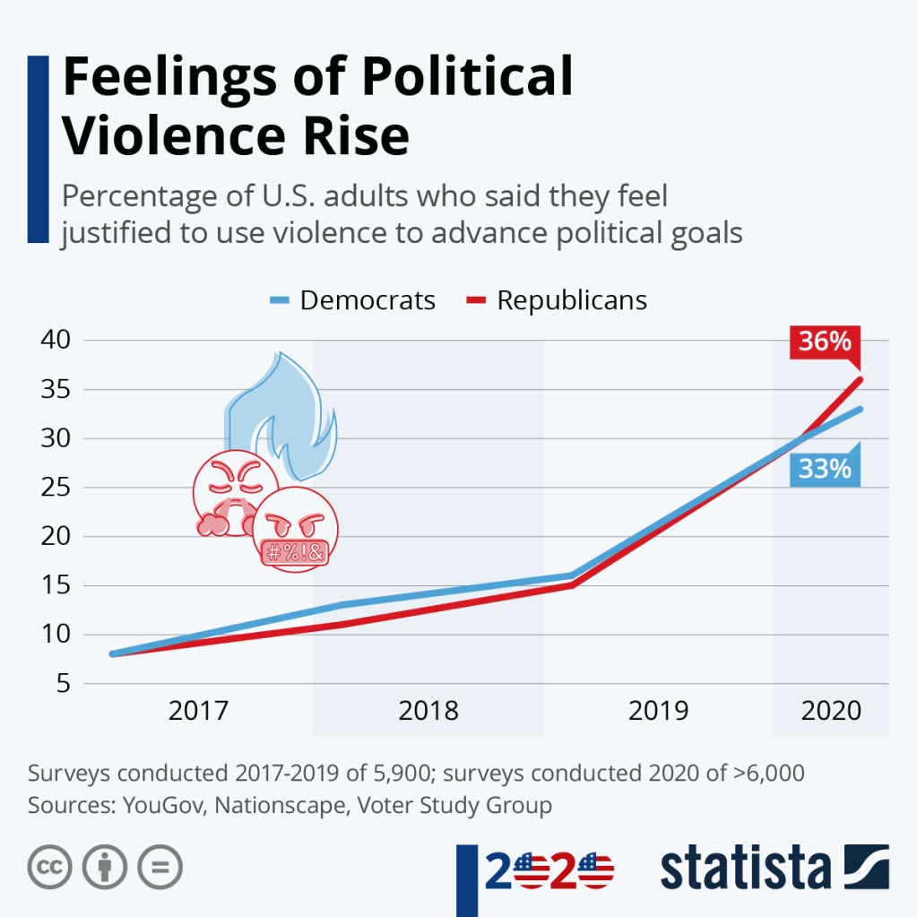

Slide 11
Long-Term Consequences of Political Violence
Democratic Backslide:
In some cases, political violence leads to the erosion of democratic institutions and the rise of authoritarian regimes.
The state may justify repressive actions by claiming a need to restore order or prevent further violence.
Example: Venezuela’s political crisis has led to the erosion of democratic norms under the authoritarian rule of President Nicolás Maduro. Example: The Israeli-Palestinian conflict has been ongoing for decades, with violence perpetrated by both sides and limited progress toward a lasting solution.

Slide 12
Strategies for Addressing Political Violence
Diplomatic Efforts:
Peace talks, negotiations, and international mediation are critical in resolving conflicts and reducing political violence.
Example: The Good Friday Agreement (1998) ended The Troubles in Northern Ireland through negotiation and power-sharing.
.

Slide 13
Conclusion
Political violence is a complex phenomenon that arises from a combination of social, economic, and political factors.
While forms of political violence such as terrorism, revolution, and civil war differ in their nature, their effects on societies are often devastating.
Addressing political violence requires not only diplomatic and legal interventions but also long-term strategies aimed at addressing the root causes like inequality, exclusion, and authoritarianism.

